Slide 1
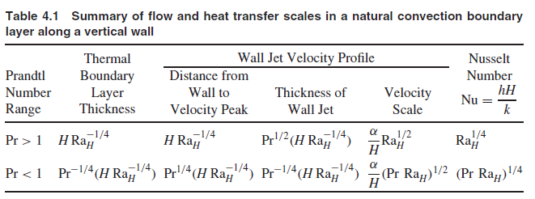

Slide 2
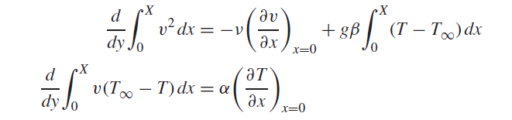
Integral solutions
Integrating the momentum equation and the energy equation from the wall (x = 0) to a far enough plane x = X in the motionless isothermal cold reservoir, we obtain the integral boundary layer equations for momentum and energy,
(1)
(2)

Slide 3

High-Pr Fluids
A suitable set of profiles for Pr > 1 fluids
(3)
1. In the limit Pr→∞, this solution reduces to
and

Slide 4

Low-Pr Fluids
For a Pr < 1 fluid, the temperature profile is combined with a new velocity profile:
(4)
In the limit Pr→0, these results become
and

Slide 5
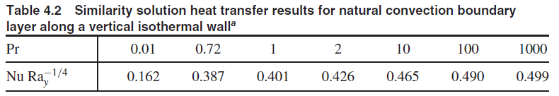
Similarity solutions
The similarity variable emerges as
and

Slide 6
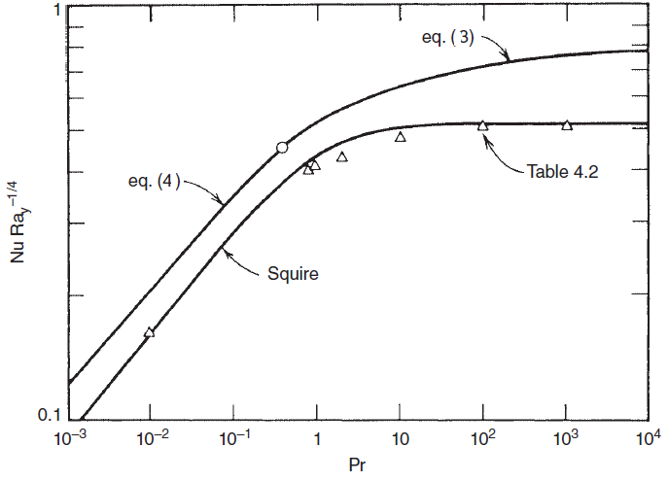
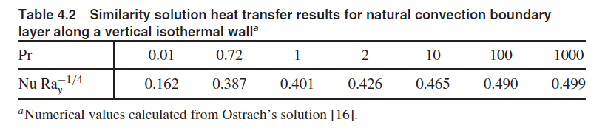
H. B. Squire, in S. Goldstein, ed., Modern Developments in Fluid Dynamics, Vol. II, Dover, New York, 1965, pp. 641–643.

Slide 7


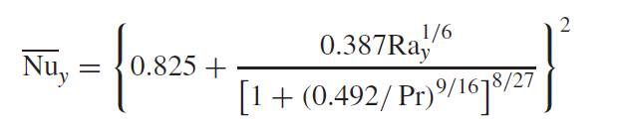
HEAT TRANSFER RESULTS INCLUDING THE EFFECT OF TURBULENCE
Vertical Walls
Transition to turbulent flow occurs at the y position where
An empirical isothermal-wall correlation that reports the wall-averaged Nusselt number Nu_{y} for the entire Rayleigh number range—laminar, transition, turbulent
Churchill and Chu [33]

Slide 8
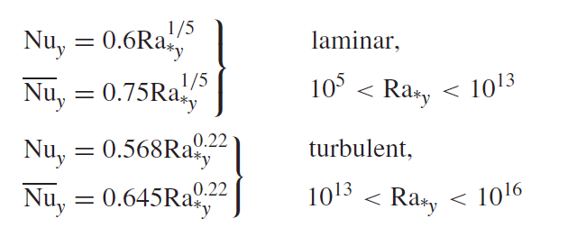
When the vertical wall is heated uniformly
Vliet and Liu (34)

Slide 9
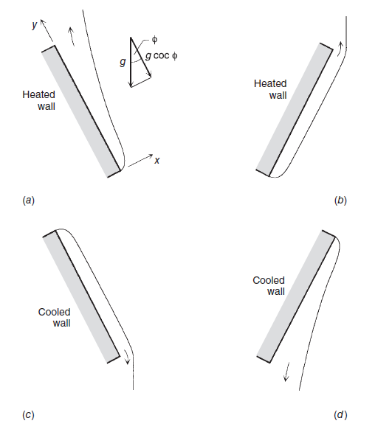

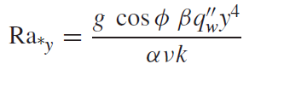
Inclined Walls
Isothermal wall
Uniform heat flux
φ is restricted to the range −60̊ <φ < −60̊
In the laminar regime momentum equation is analogous, except that g cosφ replaces g in the buoyancy term.

Slide 10
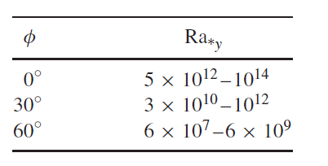
laminar–turbulent transition,
The uniform-flux wall is oriented as in cases a and d
in water experiments (Pr∼= 6.5)

Slide 11
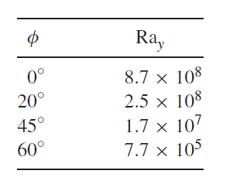
laminar–turbulent transition
Effect of wall inclination on transition along an isothermal wall [37]

Slide 12
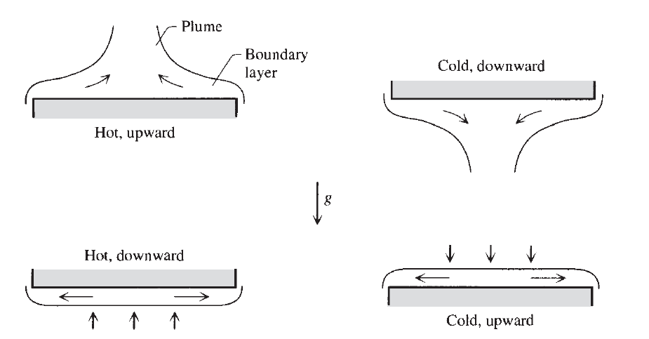

Horizontal Walls
Characteristic length
A is the area of the plane surface
p is the perimeter

Slide 13
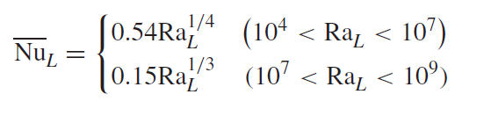

Isothermal surfaces
In the case of hot surfaces facing upward or cold surfaces facing downward the Nusselt number varies as
Pr> 0.5
Correlation for hot surfaces facing downward or cold surfaces facing upward (Fig. bottom) is

Slide 14
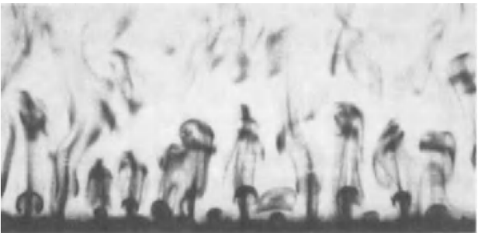
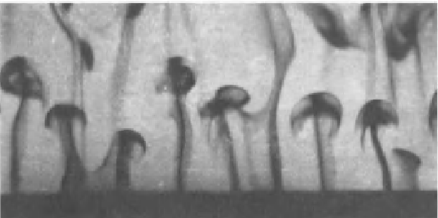
Thermals
Intermittent rise of heated fluid (thermals) from a horizontal surface facing upward in a colder pool of water Journal of Fluid Mechanics, Vol. 41, pp. 793–800, 1970.
When the temperature difference is sufficiently large

